Slide 1
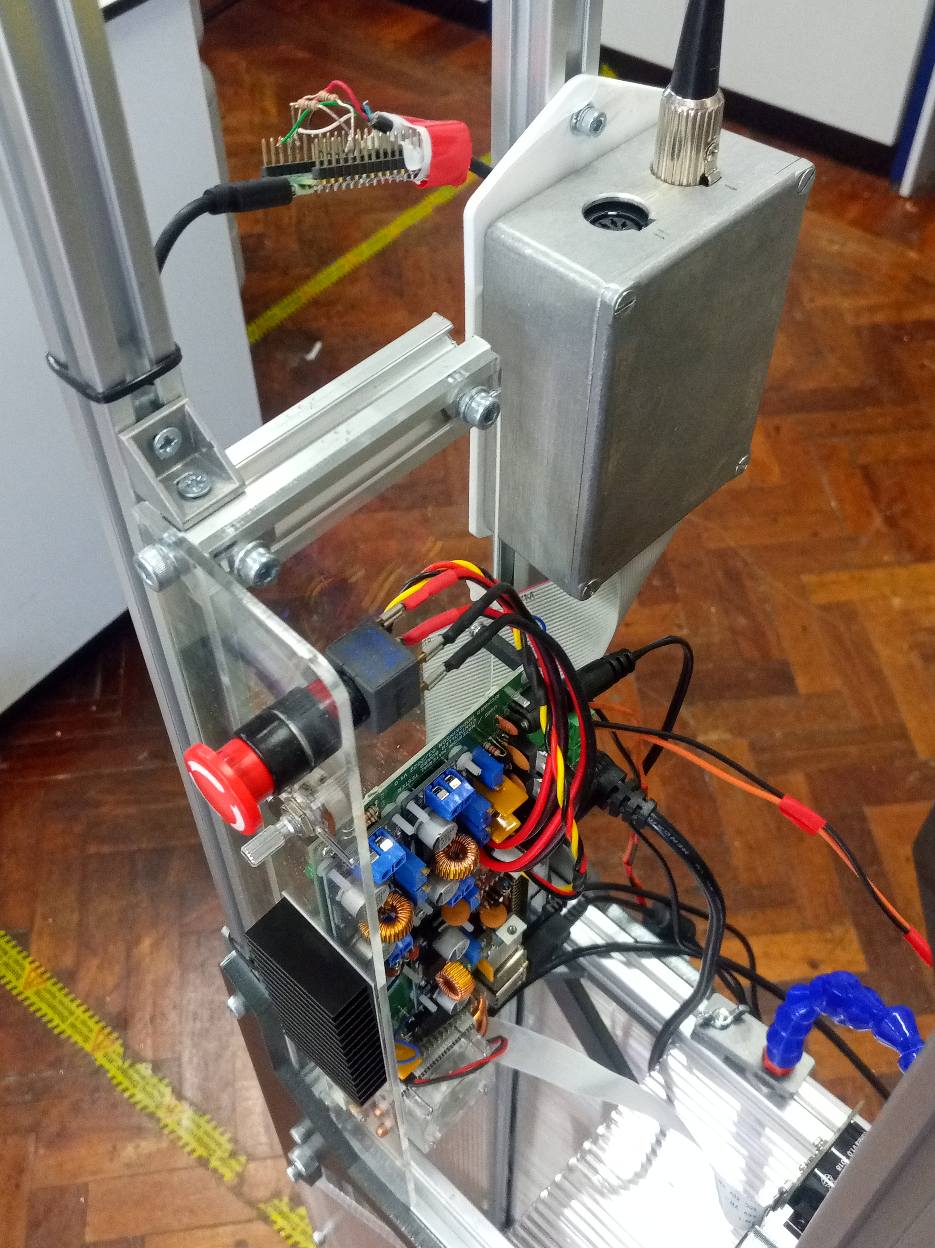
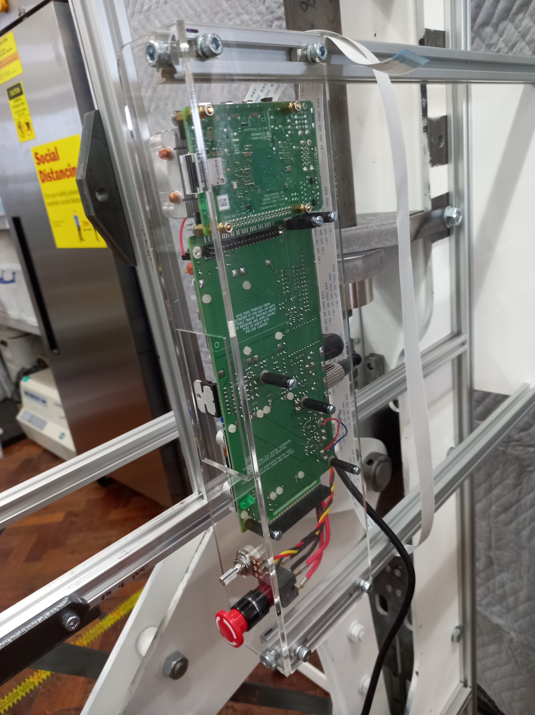
Early temporary electronics layout
Prototype temporary electronics layout
Instrument electronics slung offset from instrument side
Development Pi Pico for linear scale
Screened amplifier enclosure on isolating mounting bracket
Instrument electronics mounted across front of sample section

Slide 2
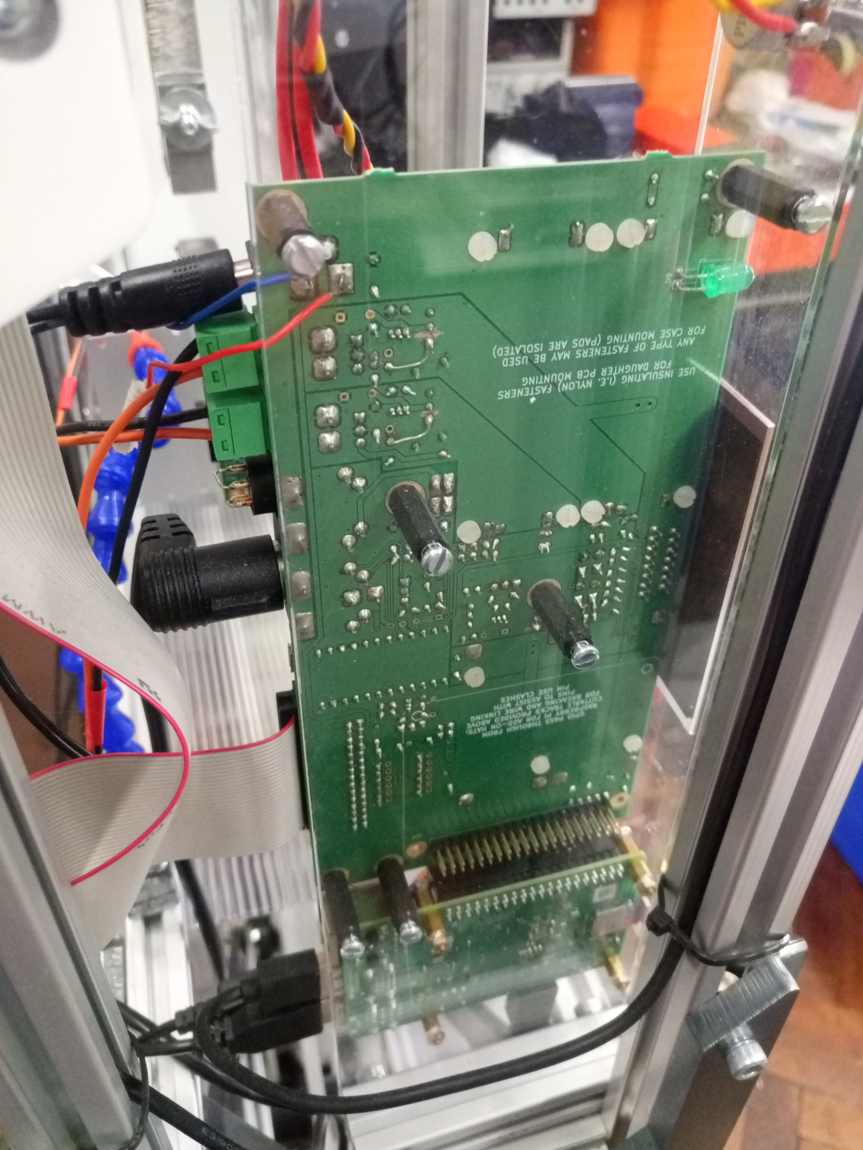
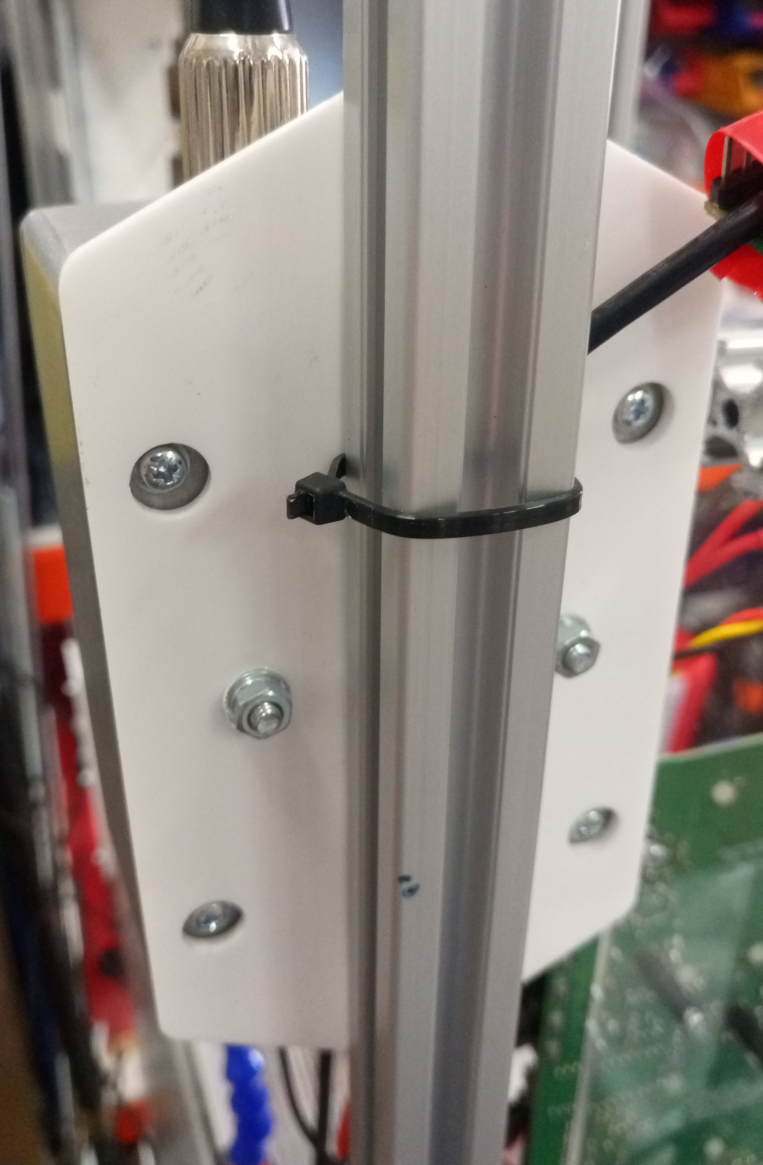
Prototype temporary electronics layout: main electronics and Raspberry Pi mounting
Prototype temporary electronics layout: amplifier box mounting on insulating bracket
Bracket – rail mounting screws
Main electronics on long pillars
PCB mounting
pillar – case screws
Case – bracket mounting screws
Raspberry Pi on short pillars

